Slide 1
Inheritance in Java

Slide 2
What is Inheritance?
Inheritance in Java is a mechanism in which one object acquires all the properties and behaviors of a parent object.
There are five types of inheritance in Java: 1) Single Inheritance 2) Multi-Level Inheritance 3) Hierarchical Inheritance 4) Hybrid Inheritance 5) Multiple Inheritance

Slide 3
In single inheritance, one child class derives from one parent class.
In multi-level inheritance, the child class derives from a class which already derived from another class.
In Hierarchical Inheritance, two or more child classes derive from one parent class.
The hybrid inheritance is the combination of more than one type of inheritance.
Multiple inheritance is not supported in java.

Slide 4
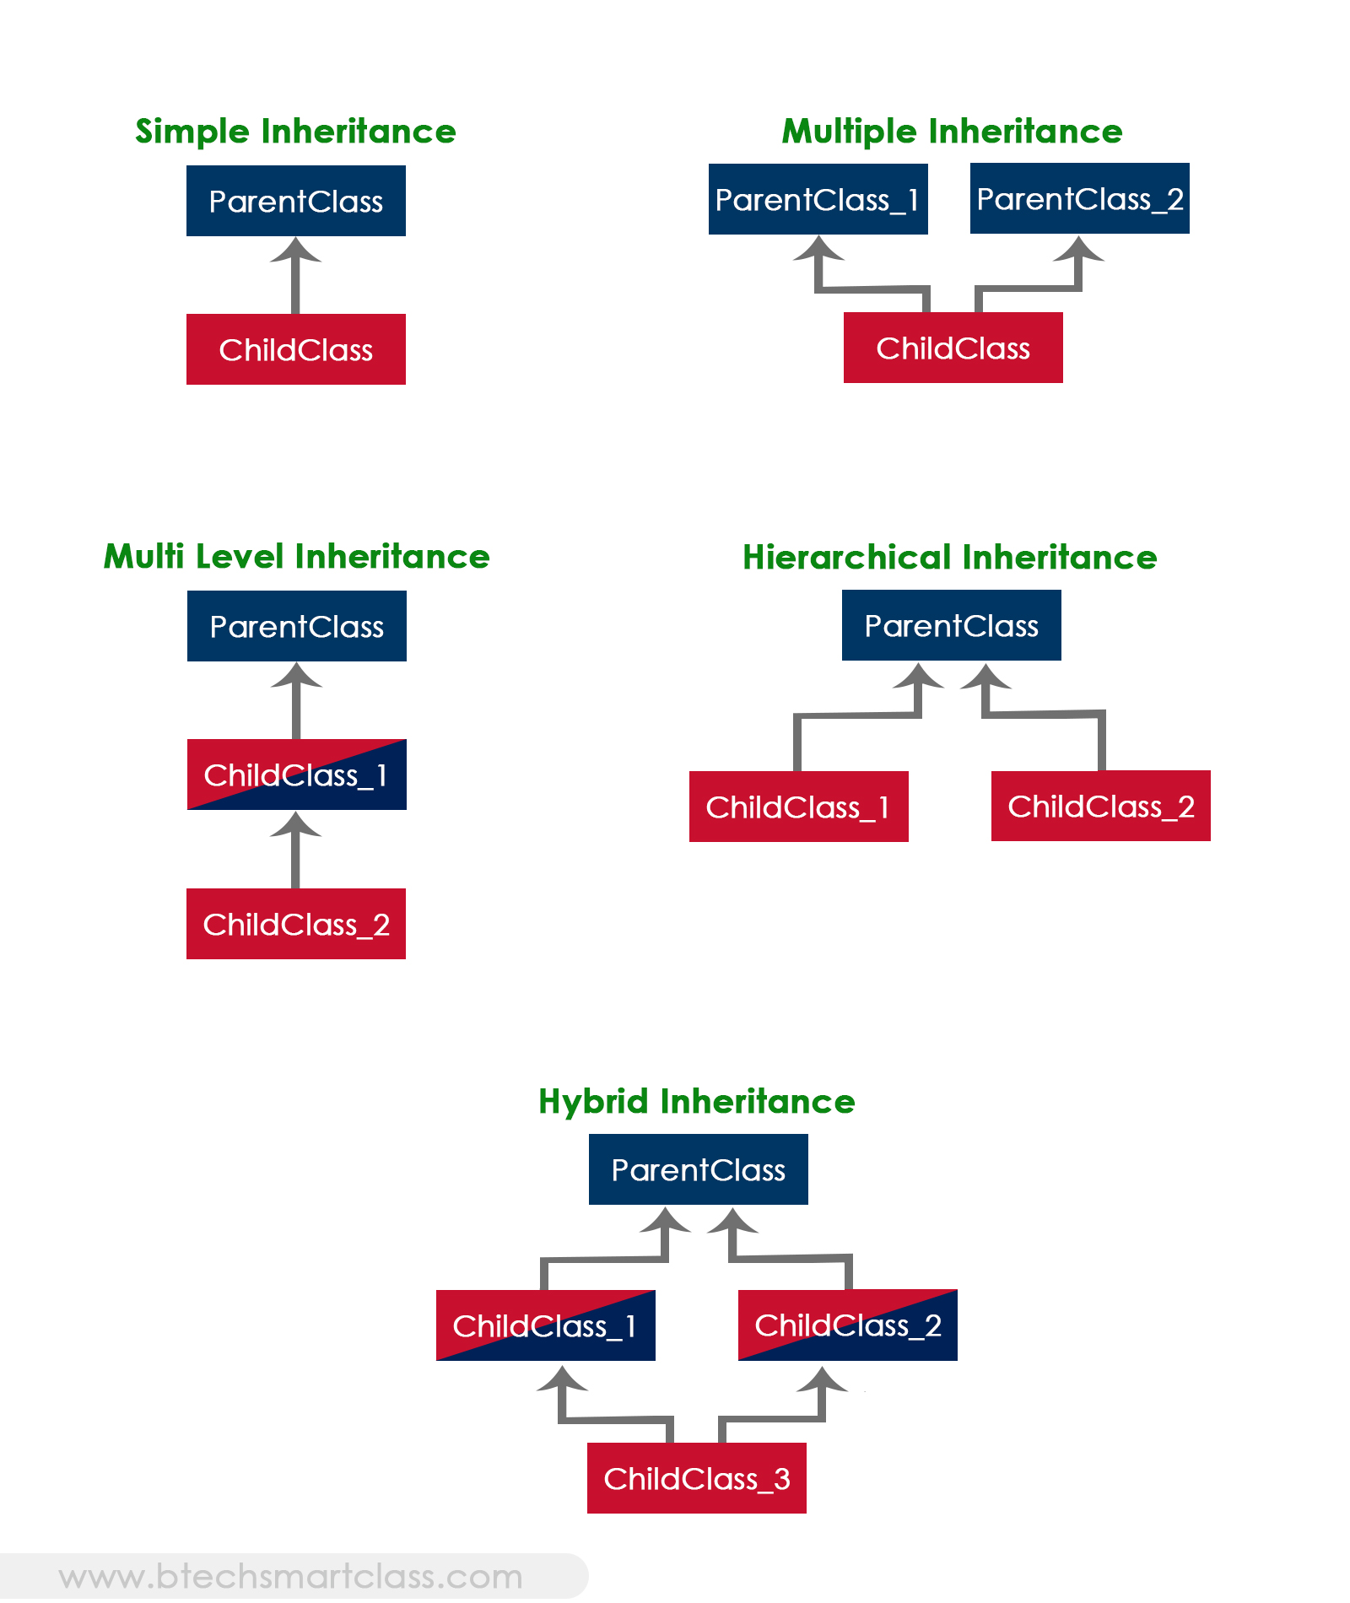

Slide 5
Java ‘extends’ Keyword
extends is the keyword used to inherit the properties of a class. Following is the syntax of extends keyword.
class Super
{ ..... ..... }
class Sub extends Super
{ ..... ..... }

Slide 6
Java ‘super’ keyword
In java, super is a keyword used to refers to the parent class object. The super keyword came into existence to solve the naming conflicts in the inheritance.
When both parent class and child class have members with the same name, then the ‘super’ keyword is used to refer to the parent class version.
In java, the super keyword is used for the following purposes.
To refer parent class data members
To refer parent class methods
To call parent class constructor
Note: The super keyword is used inside the child class only

